Slide 1
CAMEO Integration (DRAFT)
WP1, WP2, WP3

Slide 2
Meeting Overview
Look at the touch points between WP1, WP2 and WP3
Identifying how the component pieces are going to be laid out
Identify where the additional USP can be added to the project from the technical teams
Identify if there are any tasks that can take place in parallel, to assist with the integration between the components
2 Meetings to bring the parties together:
A) WP1, WP2:UCD, WP2:Vertice – Amit, Rem, Merry, Alan, Phil, Abi
B) WP3, WP2:Vertice – Gavin, Punit, Phil, Abi

Slide 3
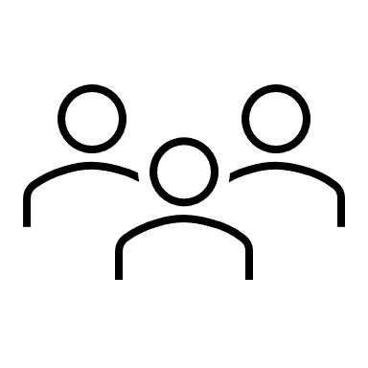
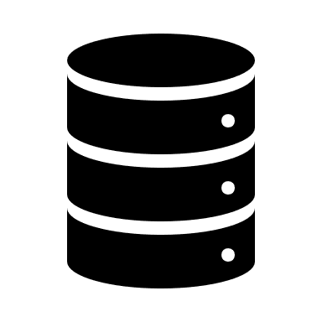



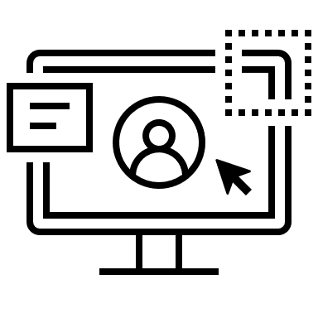


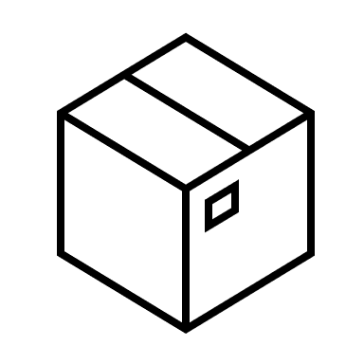
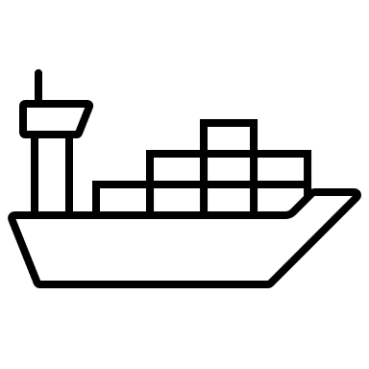



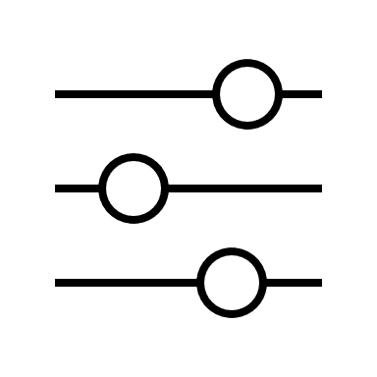


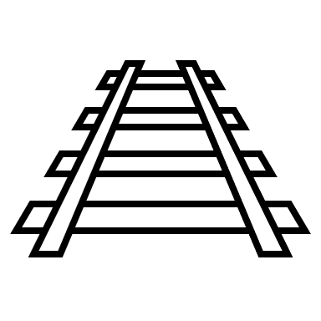

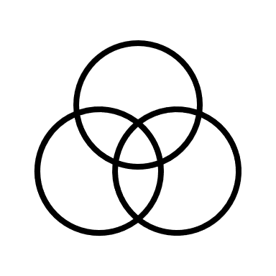
Industry view of the Architecture components
Data Lake: Data lakes hold raw, source data in a wide variety of formats to directly support data science and machine learning.
Data Lakehouse: Can eliminate data redundancy and improve data quality while offering lower cost storage. ETL pipelines provide the critical link between the unsorted lake layer and the integrated warehouse layer.
Demonstrators
Data Sources
User Interface
Structured
Semi-Structured
Unstructured
WP1 - DELL
WP2 - Vertice
WP2 - UCD
WP3 - UCD
Batch Ingestion
Data Quality / Enrichment
API
Application
Feature Engineering
Data Lake
Define Features
Select Features
Extract Features
Select Features
Semi-Structured
Package
Containerize
Deploy
Structured
Data Pipeline
Data Lakehouse
Model Development
Validate
Clean
Standardize
Curate
Structured
Semi-Structured
Code
Train
Validate
Evaluate

Slide 4
Overall Components in CAMEO
Data Sources
User Interface
Data Pipeline
Web Application
Semi-Structured
Auto Dag
Jupyter Notebooks
Validate
Clean
Standardize
Curate
Structured
Unstructured
WP2: UCD have developed a docker container with UI, Web App and Auto Dag
WP3: UCD have developed modular components that can assess the quality of the data – mainly script based and not ML based
Batch Ingestion
Data Lake
Docker Images (Catalog)
Data Brokerage
Semi-Structured
Feature Engineering
Model Development
Structured
WP1 have the batch draw down from data sources
Extract Features
Select Features
Code
Train
Validate
Evaluate
WP2: Vertice have developed docker container for MLOPs and Catalog

Slide 5
Version 1: CAMEO Architecture
Demonstrators
Data Sources
Semi-Structured
User Interface
Structured
Unstructured
Web Application
Data Brokerage
Docker Images (Catalog)
Batch Ingestion
Auto Dag
Jupyter Notebooks
EO Services
Data Lake
Feature Engineering
Model Development
Semi-Structured
Extract Features
Select Features
Code
Train
Validate
Evaluate
Structured
Major drawback to this version is that there is no enrichment of the data that has been brought into the Data Lake.
WP3 is on-demand, and not applied to all data in the data Lake. Additionally, WP3 are restricted on the data they have available to train/ develop on.

Slide 6
Version 2: CAMEO Architecture
WP3 Users
Demonstrators
Positives:
USP into the Data Lakehouse through WP3 interaction.
Ability to move the quality modules to customer area to run ‘as and when needed’.
Integration of the components to the MLOPs .
Data Sources
User Interface
User Interface
Web Application
Quality Modules
Web Application
EO Services
Semi-Structured
Auto Dag
Jupyter Notebooks
Auto Dag
Jupyter Notebooks
Data Brokerage
Docker Images (Catalog)
Structured
Unstructured
Data Quality / Enrichment
Feature Engineering
Model Development
Negatives:
Need to understand how/ where customer uploaded data will be stored and worked on.
Need to ensure that the Quality modules and WP3 work are kept in sync.
May need to rework some of the WP3 modules as they’ve been done on limited data / as part of ’as demand’ service model.
Current Web application has commercial component that needs to be reengineered.
Batch Ingestion
Define Features
Select Features
Select Features
Extract Features
Code
Train
Validate
Evaluate
Data Lake
Package
Containerize
Deploy
Semi-Structured
Data Lakehouse
Structured
Data Pipeline
Validate
Clean
Standardize
Curate
Structured
Semi-Structured

Slide 7
Follow up Questions/ Actions:
WP1: continue to migrate elements of the data lake to Oracle cloud enabling the testing of:
Cloud deployed solution
Scalability
WP2 UCD: Grant access to Vertice to a current version of the UI+WebApp_Auto Dag for testing the migration process from UCD to Cloud.
WP2 UCD: To continue development of the Web application to remove the commercial component (JointJS) to enable the full application in the future.
WP2 Vertice: present to the group the approach for docker image repository and additional notes around that. How will it work and integration to the wide partners.
WP2 UCD: Request for a meeting with Vertice to look in more detail at how the UI is put together and how we can add components to the UI effectively - Vertice to arrange.
WP3: Question for WP1 – can we get some Raster/Vector data into the data lake to enable data quality/ enrichment to be carried out on it.
WP3: Open to be the first test use cases of the UI connected to the data lake, considering the commercial component, and the fact it cannot be used externally at this point in time.
All: follow up meeting to be conducted on regular basis with representatives from WP1, WP2 and WP3 – Vertice to arrange.

